Slide 1



Hadoop Tutorial
MapReduce : InputFormat

Slide 2
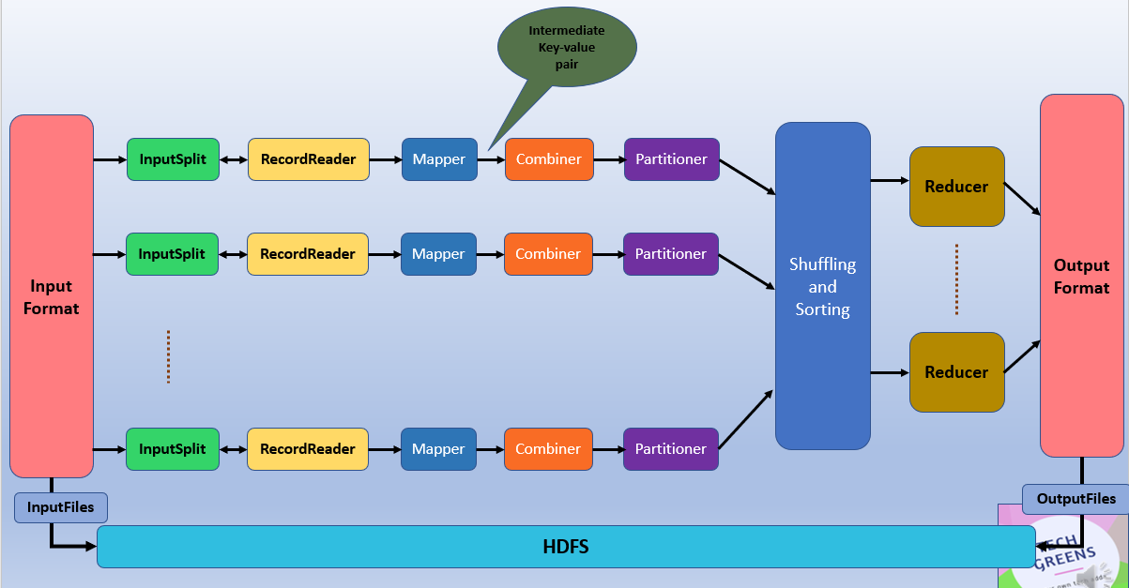

Hadoop MapReduce: InputFormat
InputFormat checks the Input-Specification of the job.
InputFormat split the Input file into InputSplit and assign to individual Mapper

Slide 3

Hadoop MapReduce
How the input files are split up and read in Hadoop is defined by the InputFormat.
InputFormat is the first component in Map-Reduce, it is responsible for creating the input splits and dividing them into records.
The files or other objects that should be used for input is selected by the InputFormat.
InputFormat defines the Data splits, which defines both the size of individual Map tasks and its potential execution server.
InputFormat defines the RecordReader, which is responsible for reading actual records from the input files.

Slide 4

InputFormat
Source code for InputFormat class
public abstract class InputFormat<K, V>
{
public abstract List<InputSplit> getSplits(JobContext context)
throws IOException, InterruptedException;
public abstract RecordReader<K, V>
createRecordReader(InputSplit split,
TaskAttemptContext context) throws IOException,
InterruptedException;
}

Slide 5

Types of InputFormat
FileInputFormat in Hadoop
Base class for all file-based InputFormats.
At the start of Job, FileInputFormat is provided with a path containing files to read.
FileInputFormat will read all files and divides these files into one or more InputSplits.
TextInputFormat
It is the default InputFormat of MapReduce. TextInputFormat treats each line of each input file as a separate record and performs no parsing. This is useful for unformatted data or line-based records like log files.
Key – It is the byte offset of the beginning of the line within the file (not whole file just one split), so it will be unique if combined with the file name.
Value – It is the contents of the line, excluding line terminators.

Slide 6

Hadoop MapReduce
KeyValueTextInputFormat
It is similar to TextInputFormat ,While TextInputFormat treats entire line as the value.
KeyValueTextInputFormat breaks the line itself into key and value by a tab character (‘/t’). Here Key is everything up to the tab character while the value is the remaining part of the line after tab character.
SequenceFileInputFormat
Hadoop SequenceFileInputFormat is an InputFormat which reads sequence files.
Sequence files are binary files that stores sequences of binary key-value pairs.
Sequence files block-compress and provide direct serialization and deserialization of several data types.

Slide 7

Hadoop MapReduce
SequenceFileAsTextInputFormat
Hadoop SequenceFileAsTextInputFormat is another form of SequenceFileInputFormat which converts the sequence file key values to Text objects.
By calling ‘tostring()’ conversion is performed on the keys and values. This InputFormat makes sequence files suitable input for streaming.
SequenceFileAsBinaryInputFormat
Hadoop SequenceFileAsBinaryInputFormat is a SequenceFileInputFormat using which we can extract the sequence file’s keys and values as an opaque binary object.

Slide 8

Hadoop MapReduce
NLineInputFormat
Hadoop NLineInputFormat is another form of TextInputFormat where the keys are byte offset of the line and values are contents of the line. If we want our mapper to receive a fixed number of lines of input, then we use NLineInputFormat. N is the number of lines of input that each mapper receives. By default (N=1), each mapper receives exactly one line of input. If N=2, then each split contains two lines. One mapper will receive the first two Key-Value pairs and another mapper will receive the second two key-value pairs.
DBInputFormat
Hadoop DBInputFormat is an InputFormat that reads data from a relational database, using JDBC. As it doesn’t have portioning capabilities, so we need to careful not to swamp the database from which we are reading too many mappers. So it is best for loading relatively small datasets, perhaps for joining with large datasets from HDFS using MultipleInputs. Here Key is LongWritables while Value is DBWritables.

Slide 9
Conclusion
InputFormat defines how to split and read input files.
InputFormat defines RecordReader.
One can also use different types of InputFormats for the different purpose.

Slide 10
Thanks and do subscribe to my channel

